Slide 1

States, Economies and Societies Research Group
Ed & Qiujie

Slide 2
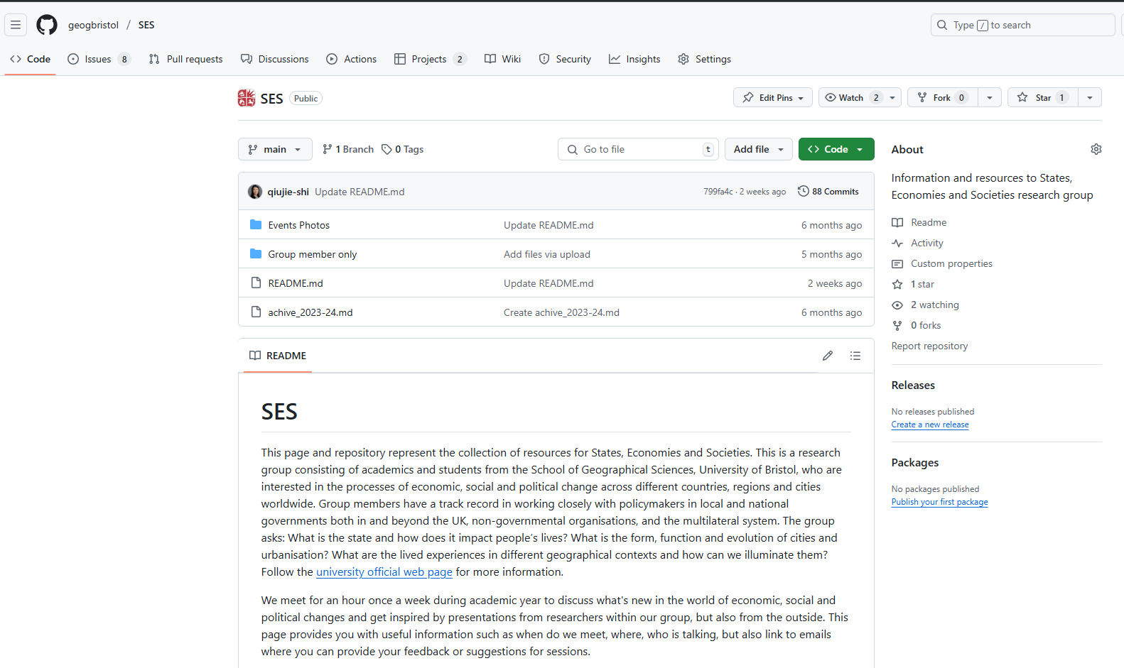
Who are we?
https://github.com/geogbristol/SES

Slide 3
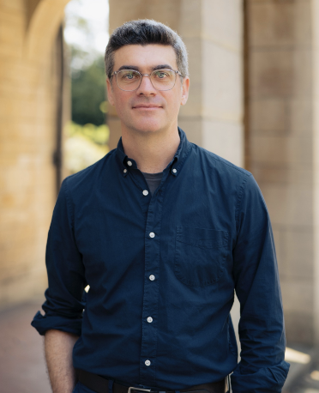
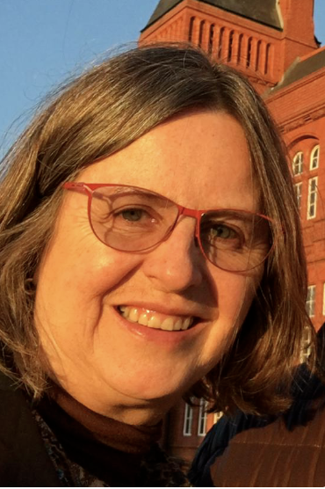
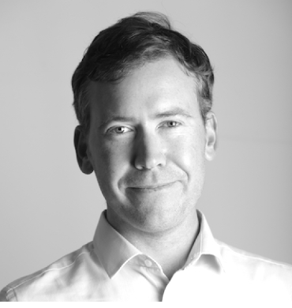
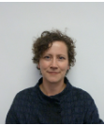
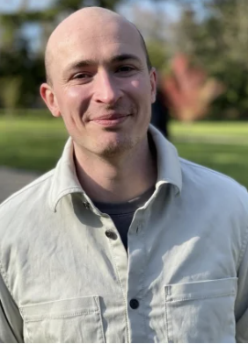
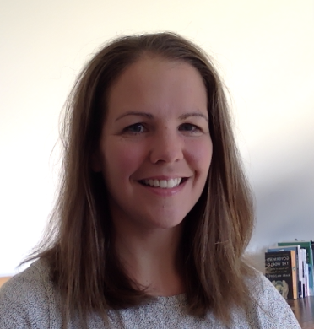
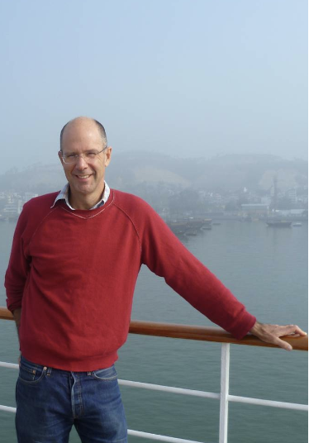


Who are we?
Global urbanization
Urban governance
Globally-focused, multi-scalar, mixed-method research to address pressing challenges at the intersection of political, economic and social geography.
Health & Politics
Work & Employment
Urban health
Energy
Rural Asia
Smart city
Urban China

Slide 4
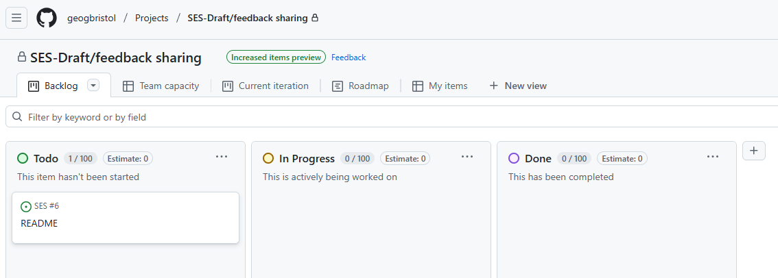
As a PGR….how to get involved?
Weekly seminar (blue-sky ideas / working papers all welcome)
PGR lunch + half-day session (29/04/2025)
Staff & PGR group away day – tell us what you want (7/6/25)
Draft sharing
… And lots of amazing PGRs!

